Slide 1

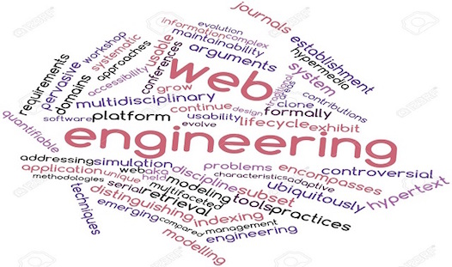
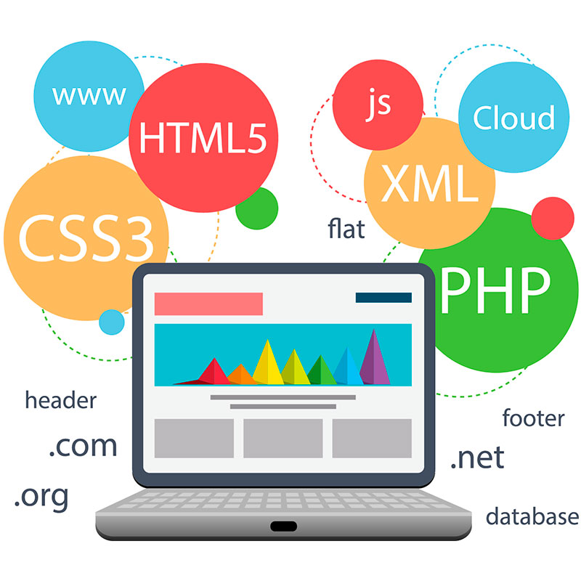

Slide 2
OUTLINE
Recap
Introduction
Web Engineering
Categories of Web Applications
Characteristics of Web Applications

Slide 3





Recap
Introduction Web Engineering Categories of Web Applications Characteristics of Web Application
Web Browser (Software to access web)
WWW (World Wide Web-Internet Based Service)
Web Server (Computer system that processes request via HTTP)
World Wide Web Consortium (Founded in 1994 by Tim Berners-Lee)

Slide 4
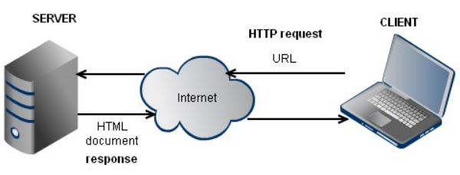
Recap
Introduction Web Engineering Categories of Web Applications Characteristics of Web Application

Slide 5
What is engineering?
Introduction Web Engineering Categories of Web Applications Characteristics of Web Application
Engineering in general means the practical application of science to commerce or industry with the goal of designing applications in a better, i.e. faster / cheaper / more secure / etc., way than hitherto.

Slide 6
What is software engineering?
Introduction Web Engineering Categories of Web Applications Characteristics of Web Application
Software Engineering is defined as the application of science and mathematics by which the capabilities of computer equipment are made useful to man via computer programs, procedures, and associated documentation.

Slide 7
What is Web engineering?
Introduction Web Engineering Categories of Web Applications Characteristics of Web Application
IT is an independent branch of software engineering.
Web Engineering comprises the use of systematic and quantifiable approaches in order to accomplish the specification, implementation, operation, and maintenance of high-quality Web applications.
It is also the scientific discipline concerned with the study of these approaches.

Slide 8

Web application
Introduction Web Engineering Categories of Web Applications Characteristics of Web Application
A Web application is a software system based on technologies and standards of the World Wide Web Consortium (W3C) that provides web specific resources such as content and services through a user interface, the Web browser.
Web applications are full fledge, complex software system.
Therefore, the development of Web applications requires a methodologically sound engineering approach.
Main stream software application.

Slide 9
Basic Principles of Web Engineering
Introduction Web Engineering Categories of Web Applications Characteristics of Web Application
Clearly defined goals and requirements
Systematic development of a Web application in phases
Careful planning of these phases
Continuous audit of the entire development process.
These basic principles of Web Engineering can, however, be described similarly to those of Software Engineering

Slide 10

Classification of Web
Introduction Web Engineering Categories of Web Applications Characteristics of Web Application
Web
the Shallow Web (Static Web)
Dynamic Web
the Wisdom Web
the Mobile Web
the Semantic Web
Web 1.0
Web 2.0
DARK WEB

Slide 11
Categories & Attributes of Web App
ATTRIBUTES
Network intensive
Concurrent
Unpredictable loading
Performance sensitive
High availability
Data driven
Content sensitive
Continuous evolution
Immediacy
Security
Aesthetics
CATEGORIES
Document centric Web sites
Interactive Web
Transactional Web applications
Workflow-based Web applications
Collaborative Web applications
Social Web
Portal-oriented Web applications
Ubiquitous Web applications
Semantic Web
Web APP

Slide 12
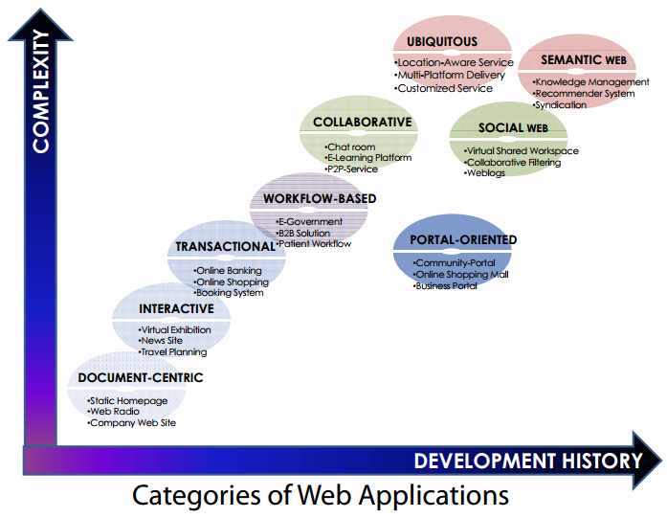
Introduction Web Engineering Categories of Web Applications Characteristics of Web Application

Slide 13


Document centric web sites
Introduction Web Engineering Categories of Web Applications Characteristics of Web Application
These are static HTML documents present on a Web server
Manual changes to the documents are required to update any information
Pros !
Simple, stable, short response times
Cons!
High management costs for frequent updates & large collection
Danger of inconsistent and outdated information

Slide 14


Interactive Web Applications
Introduction Web Engineering Categories of Web Applications Characteristics of Web Application
With the introduction of the Common Gateway Interface (CGI)and HTML forms, interactive Web applications emerged.
Offering a first, simple, form of interactivity by means of
forms, radio buttons and selection menus.
Web pages and links to other pages are generated dynamically according to user input.
Examples
virtual exhibitions, news sites, or timetable information.

Slide 15


Transactional Web Applications
Introduction Web Engineering Categories of Web Applications Characteristics of Web Application
Transactional Web applications were created to provide more interactivity, giving the user the possibility of not only interacting with the application in a read-only manner, but also by performing updates on the underlying content.
Considering a tourism information system this would allow, for example, to update the content in a decentralized way or make it possible to book rooms.
The prerequisite for this are database systems that allow efficient and consistent handling of the increasing amount of content in Web applications and offer the possibility of structured queries.
Examples
Online banking, online shopping, and booking systems belong in this category.

Slide 16


Workflow-based Web applications
Introduction Web Engineering Categories of Web Applications Characteristics of Web Application
These applications allow the handling of workflows within or between different companies, public authorities, and private users.
A driving force for this is the availability of appropriate Web services to guarantee interoperability.
The complexity here lies in
The autonomy of the participating companies.
The necessity for workflows to be robust and flexible.
Examples
Business-to-Business solutions, e-commerce, Web-based support of patient workflows in the health sector

Slide 17



Collaborative Web applications
Introduction Web Engineering Categories of Web Applications Characteristics of Web Application
Collaborative web applications are online platforms to allow multiple users to work together in real-time or asynchronously on shared tasks, projects, or activities.
These applications are particularly useful for teamwork, communication, and productivity in both personal and professional contexts.
Whereas workflow-based Web applications require a certain structuring of the automated processes and operations, collaborative Web applications are employed especially for cooperation purposes in unstructured operations (groupware).
Examples
e-Learning systems, scheduling systems, Chat rooms

Slide 18

Social Web
Introduction Web Engineering Categories of Web Applications Characteristics of Web Application
Social networks provide a socializing facility to a targeted audience
People with similar interests can interact with each other
While originally the Web was characterized by anonymity, there is an increasing trend towards a social Web, where people provide their identity to a (small) community of others with similar interests.
Examples
Instagram, Weblogs (blogs), etc.

Slide 19



Portal-oriented Web applications
Introduction Web Engineering Categories of Web Applications Characteristics of Web Application
A single point of access to multiple services in a particular domain or multiple domains
Examples include Google, Yahoo, etc.
Specialized Web portals are also popular, i.e., business portals, health-sector portals, market portals, community portals etc.

Slide 20


Ubiquitous Web applications
Introduction Web Engineering Categories of Web Applications Characteristics of Web Application
It provides customized services anytime anywhere and for any device, thus facilitating ubiquitous access.
Examples
Displaying the menu of the day on the mobile devices of all users entering a restaurant between 11 am and 2 pm.
For this type of system it is important to take into account the limitations of mobile devices (bandwidth, screen size, memory, immaturity of software, etc.)
and the context in which the Web application is currently being used. Based on this dynamic adjustments according to the users’ situation can be made.

Slide 21


Semantic Web
Introduction Web Engineering Categories of Web Applications Characteristics of Web Application
The goal of the Semantic Web is to present information on the Web not merely for humans, but also in a machine-readable form.
This would facilitate knowledge management on the Web, in particular the linking and reuse of knowledge, as well as locating new relevant knowledge, e.g. by means of recommender systems.

Slide 22

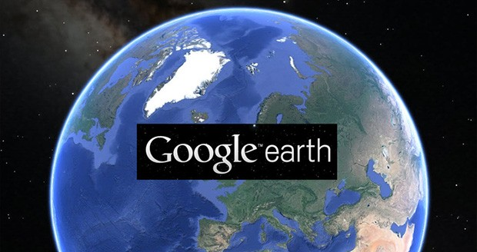
Rich Internet Applications
Web based applications that run in a Web browser and do not require software installation, but still have the features & functionality of traditional desktop applications.
RIA represents the evolution of the browser from static request response interface to dynamic, asynchronous interface.
RIAs promise a richer user experience & benefits, interactivity & usability .

Slide 23
Characteristics of Web Applications

Slide 24
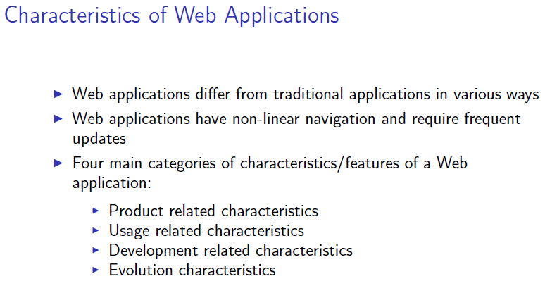
Introduction Web Engineering Categories of Web Applications Characteristics of Web Application

Slide 25
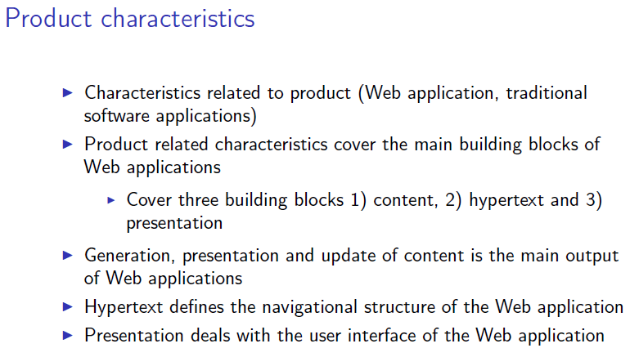
Introduction Web Engineering Categories of Web Applications Characteristics of Web Application

Slide 26
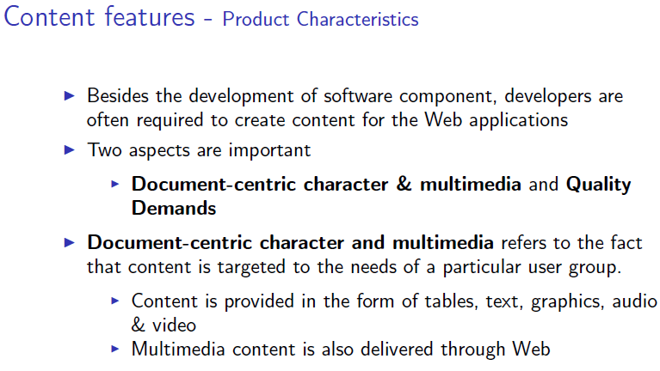
Introduction Web Engineering Categories of Web Applications Characteristics of Web Application

Slide 27
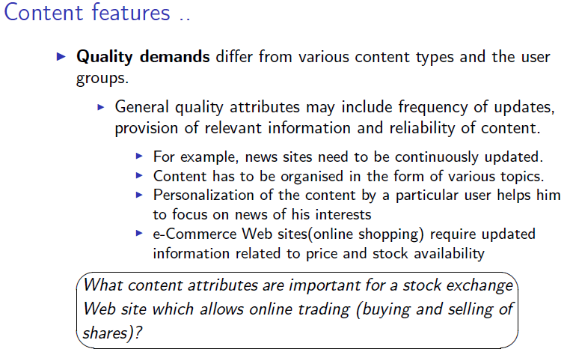
Introduction Web Engineering Categories of Web Applications Characteristics of Web Application

Slide 28
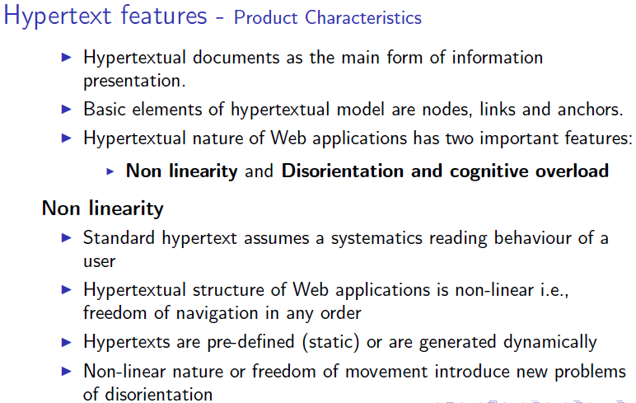
Introduction Web Engineering Categories of Web Applications Characteristics of Web Application

Slide 29
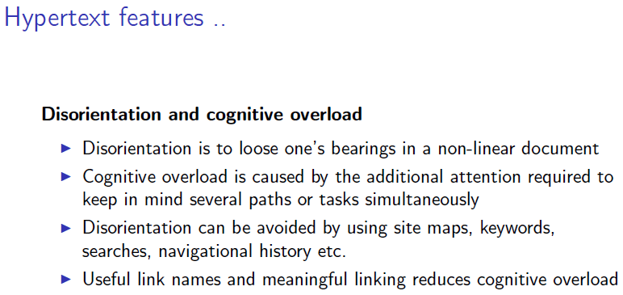
Introduction Web Engineering Categories of Web Applications Characteristics of Web Application

Slide 30
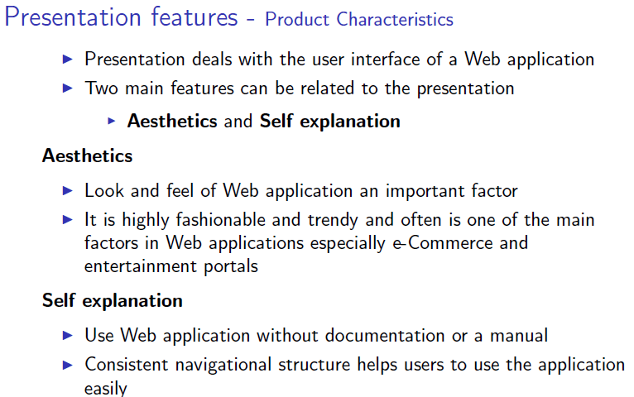
Introduction Web Engineering Categories of Web Applications Characteristics of Web Application

Slide 31
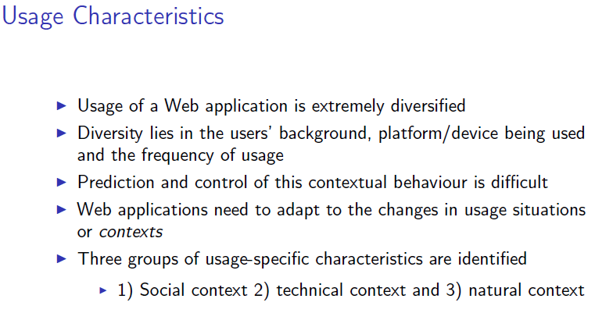
Introduction Web Engineering Categories of Web Applications Characteristics of Web Application

Slide 32
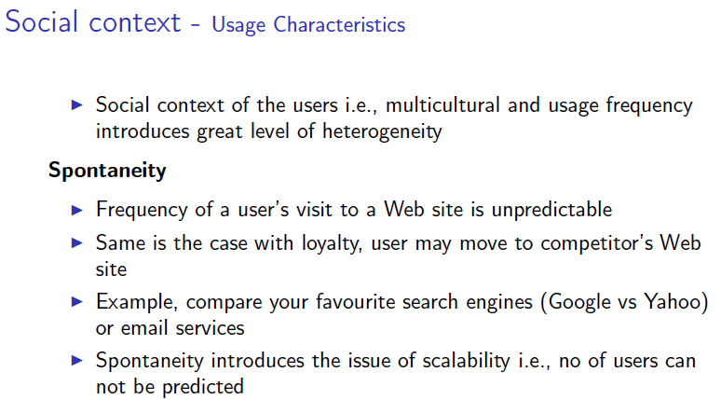
Introduction Web Engineering Categories of Web Applications Characteristics of Web Application

Slide 33
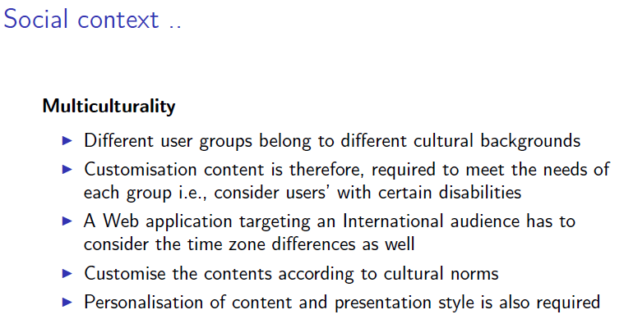
Introduction Web Engineering Categories of Web Applications Characteristics of Web Application

Slide 34
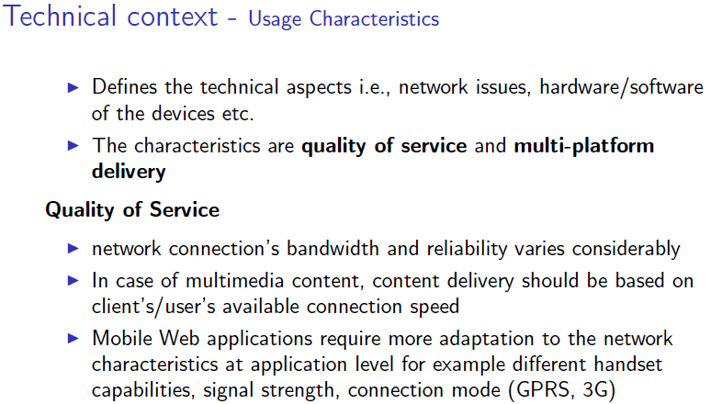
Introduction Web Engineering Categories of Web Applications Characteristics of Web Application

Slide 35
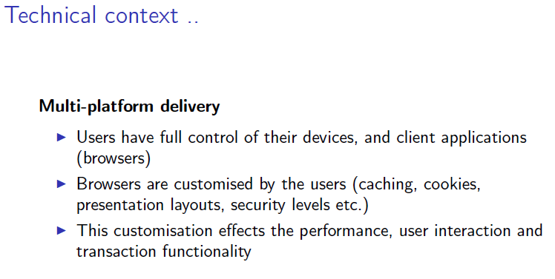
Introduction Web Engineering Categories of Web Applications Characteristics of Web Application

Slide 36
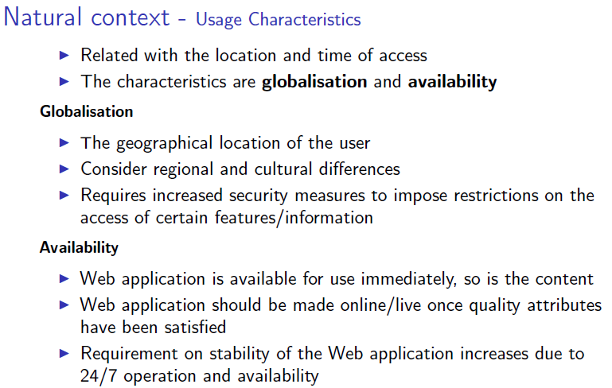
Introduction Web Engineering Categories of Web Applications Characteristics of Web Application

Slide 37
Development related Characteristics
The development of Web applications is characterized by the necessary resources, such as the development team and the technical infrastructure, the development process itself, and the necessary integration of already existing solutions.

Slide 38
Development related Characteristics
Development team:
The development of Web applications is strongly influenced by the fact that development teams are multidisciplinary and generally rather young.
These factors and the methods of the so-called community development contribute to a completely new way of organizing collaboration of different groups of developers.
The different points of view and emphases must be brought together through appropriate project management and an adapted development process

Slide 39
Development related Characteristics
Technical infrastructure:
The inhomogeneity and immaturity of the used components are important characteristics of the technical infrastructure of Web applications.
Inhomogeneity:
The development of Web applications depends on two external components: server and browser.
While the Web server can usually be configured and operated as desired by the application programmers, there is no way to influence the users’ Web browsers and their individual preferences.
This situation is additionally complicated by different browser versions and their inter-operation with
Immaturity:
Because of the increasing time-to-market pressure, components used in Web applications are often immature, i.e. they either have bugs or lack the desired functionality.
Additionally, a version update of the Web application often entails a change of the development environment.
As a result, development knowledge is often lost or cannot even evolve in the first place.

Slide 40
Development related Characteristics
Development process:
The development process is the framework for all development-related characteristics, and is in turn influenced by flexibility and parallelism

Slide 41
Development related Characteristics
Development integration:
A special characteristic of many Web applications is the need for internal and external integration. Integration in this context refers not only to technical aspects, but also to content, and organizational aspects.

Slide 42
Evolution characteristic
Evolution is a characteristic that governs all three dimensions of product, usage and development.
The need for evolution can be argued for with the continuous change of requirements and conditions, the competitive pressure, and the general fast pace of development.

Slide 43

Why do web projects fail?
Not meeting functionality and the user’s need
Poor usability
Poor performance
Security breaches
Poor maintainability
Poor scalability
Use of immature technology
Schedule & cost over-runs
Poor project management
Inability to handle project’s complexity
Stakeholder politics
Commercial pressures
Poor reporting & monitoring of project progress

